Slide 1
Loops and Logic

Slide 2
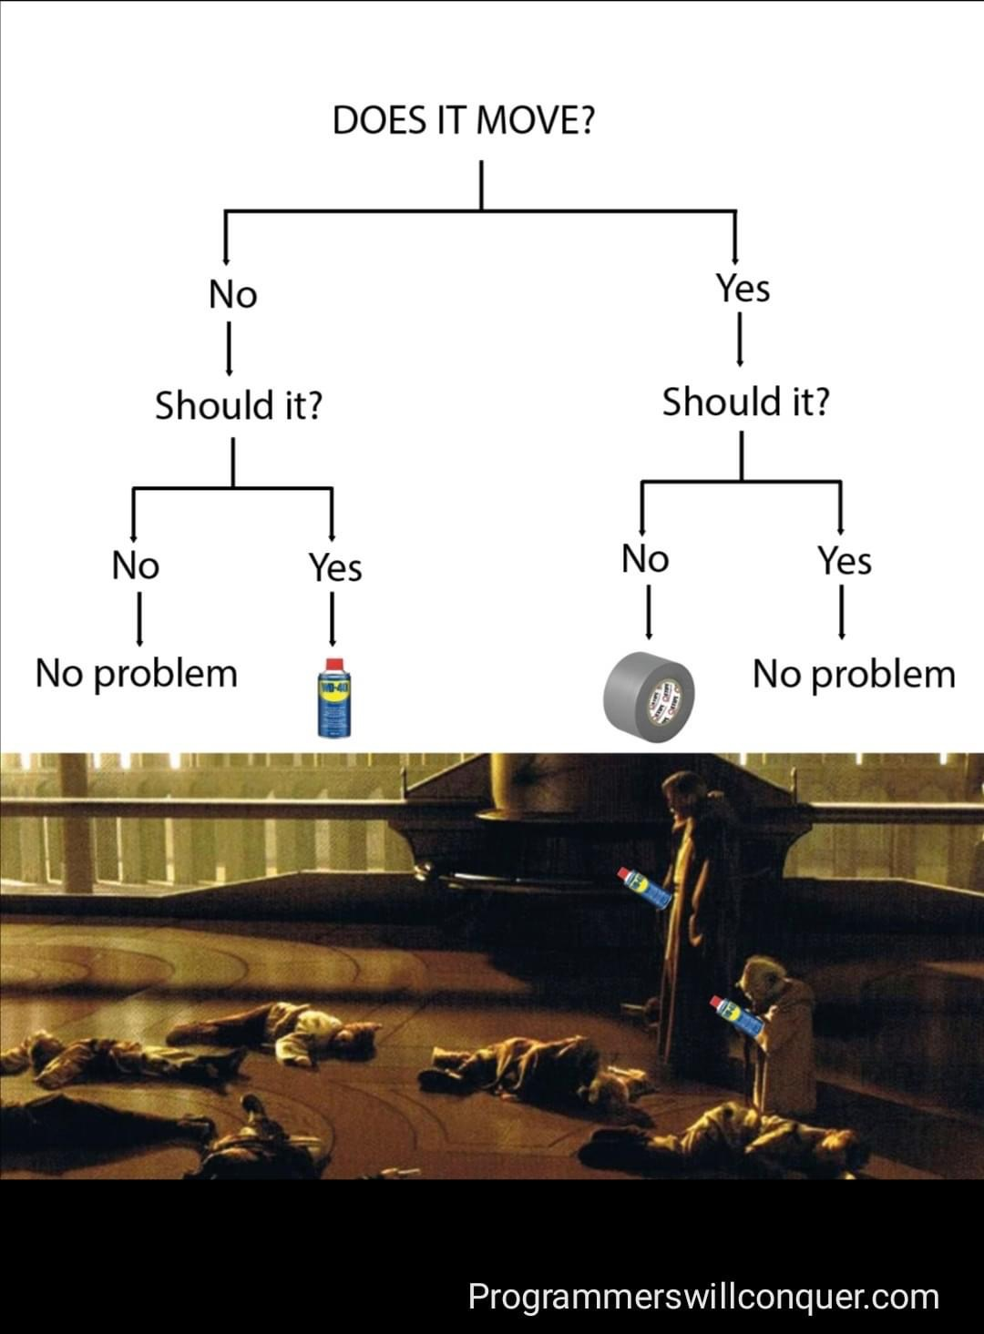
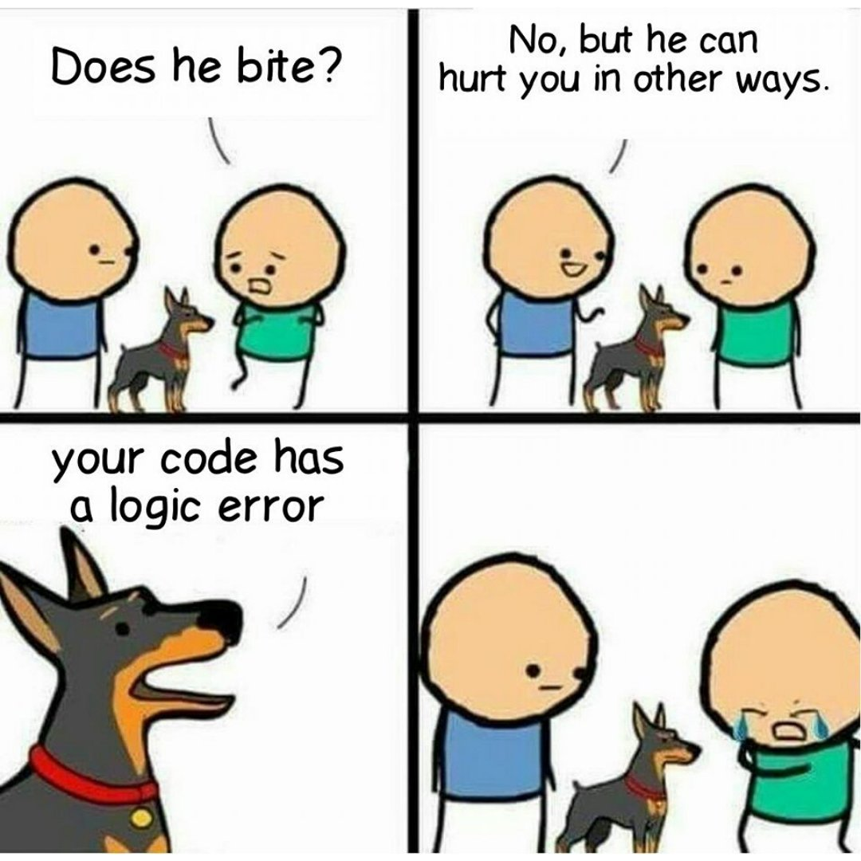
Logic
What is “logic”? What does it mean? What do we use it to represet? Why do we use it?

Slide 3
What?
Logic in programming is very similar to logic in real life. Is either “true” or “false”

Slide 4
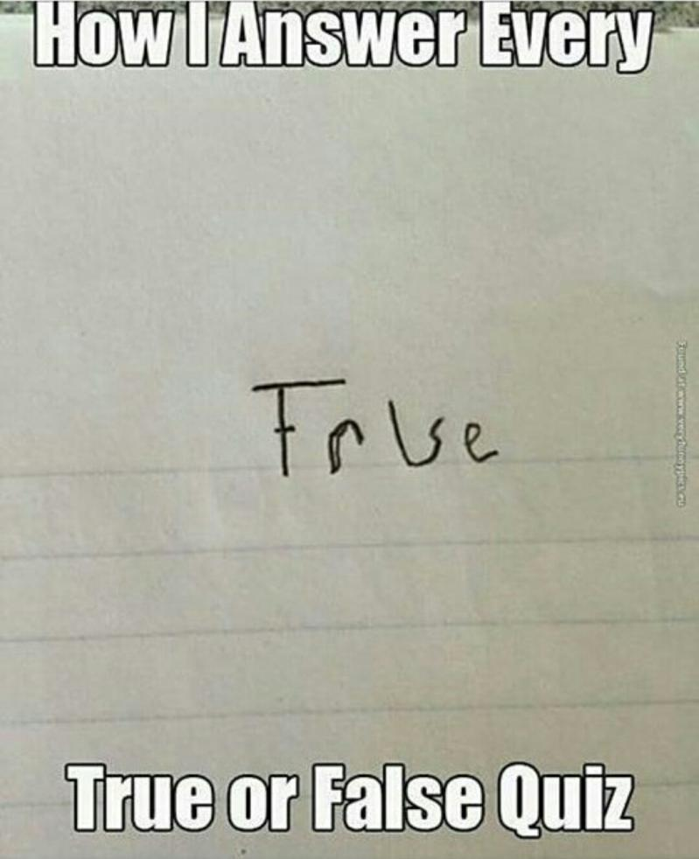
True or False?
True
False
1+1 = 2
3 > 2
TRUE
1 AND 1
1 OR 0
1+1 = 3
3 < 2
FALSE
1 AND 0
0 AND 0
0 AND 1
0 OR 0
NOT TRUE
DO NOT DO THIS!

Slide 5
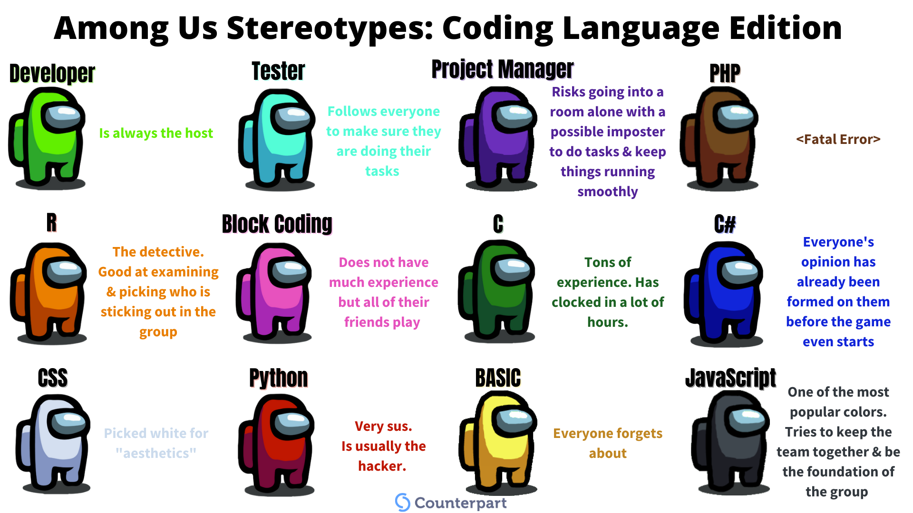

Slide 6
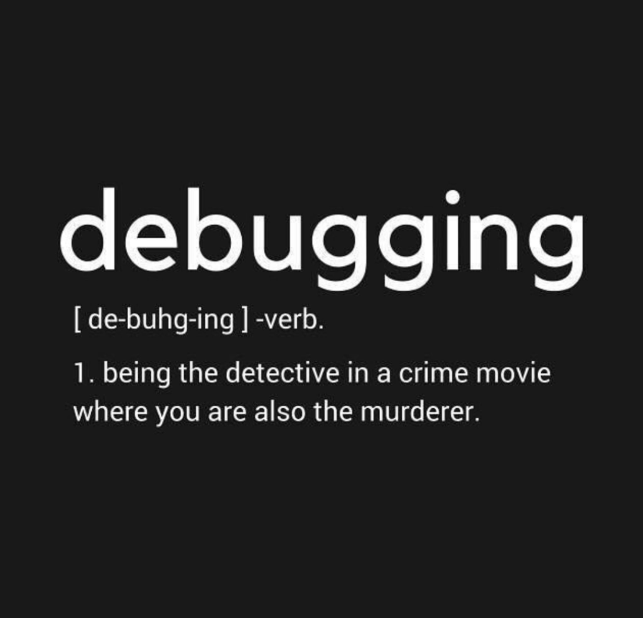

Slide 7
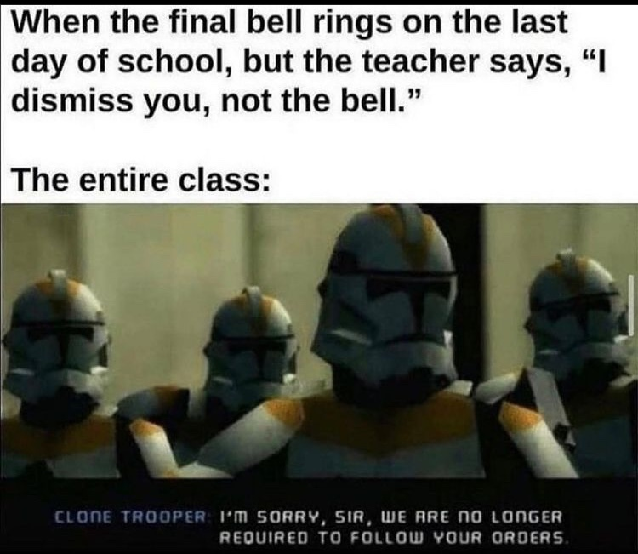
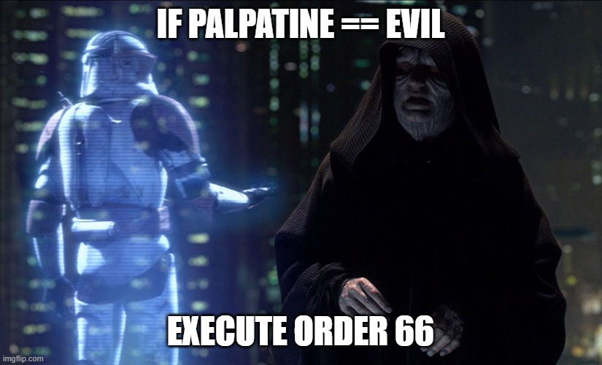
If statement
“If” statements are like asking a question and if the answer is correct (True) then execute the following order. If the answer is not correct then we do not execute the next order and just move on.
DO NOT DO THIS. TEACHER ALWAYS DISMISSES YOU!

Slide 8
EXAMPLE

Slide 9
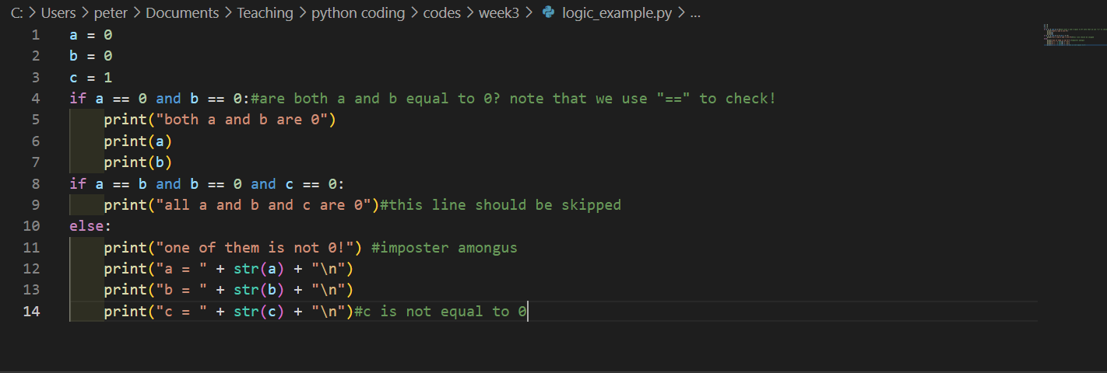
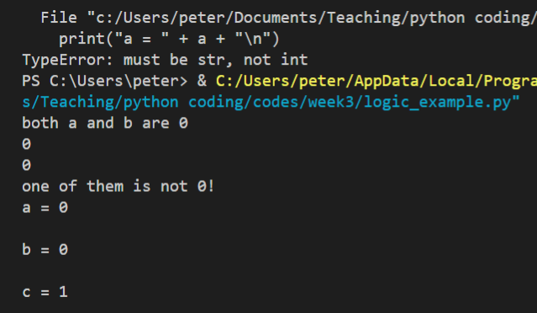

Slide 10
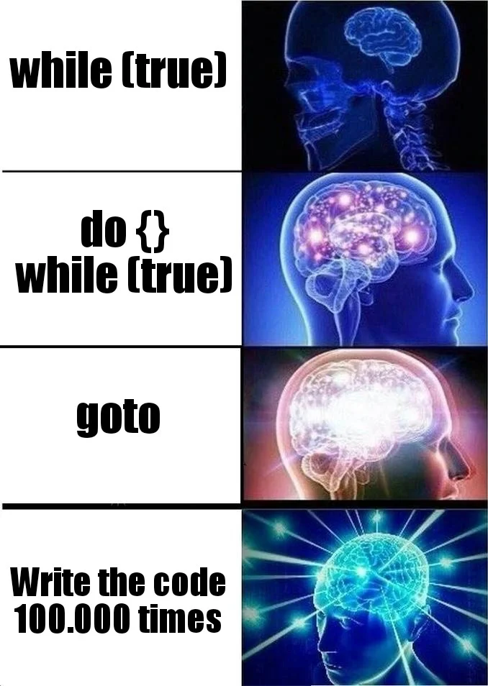
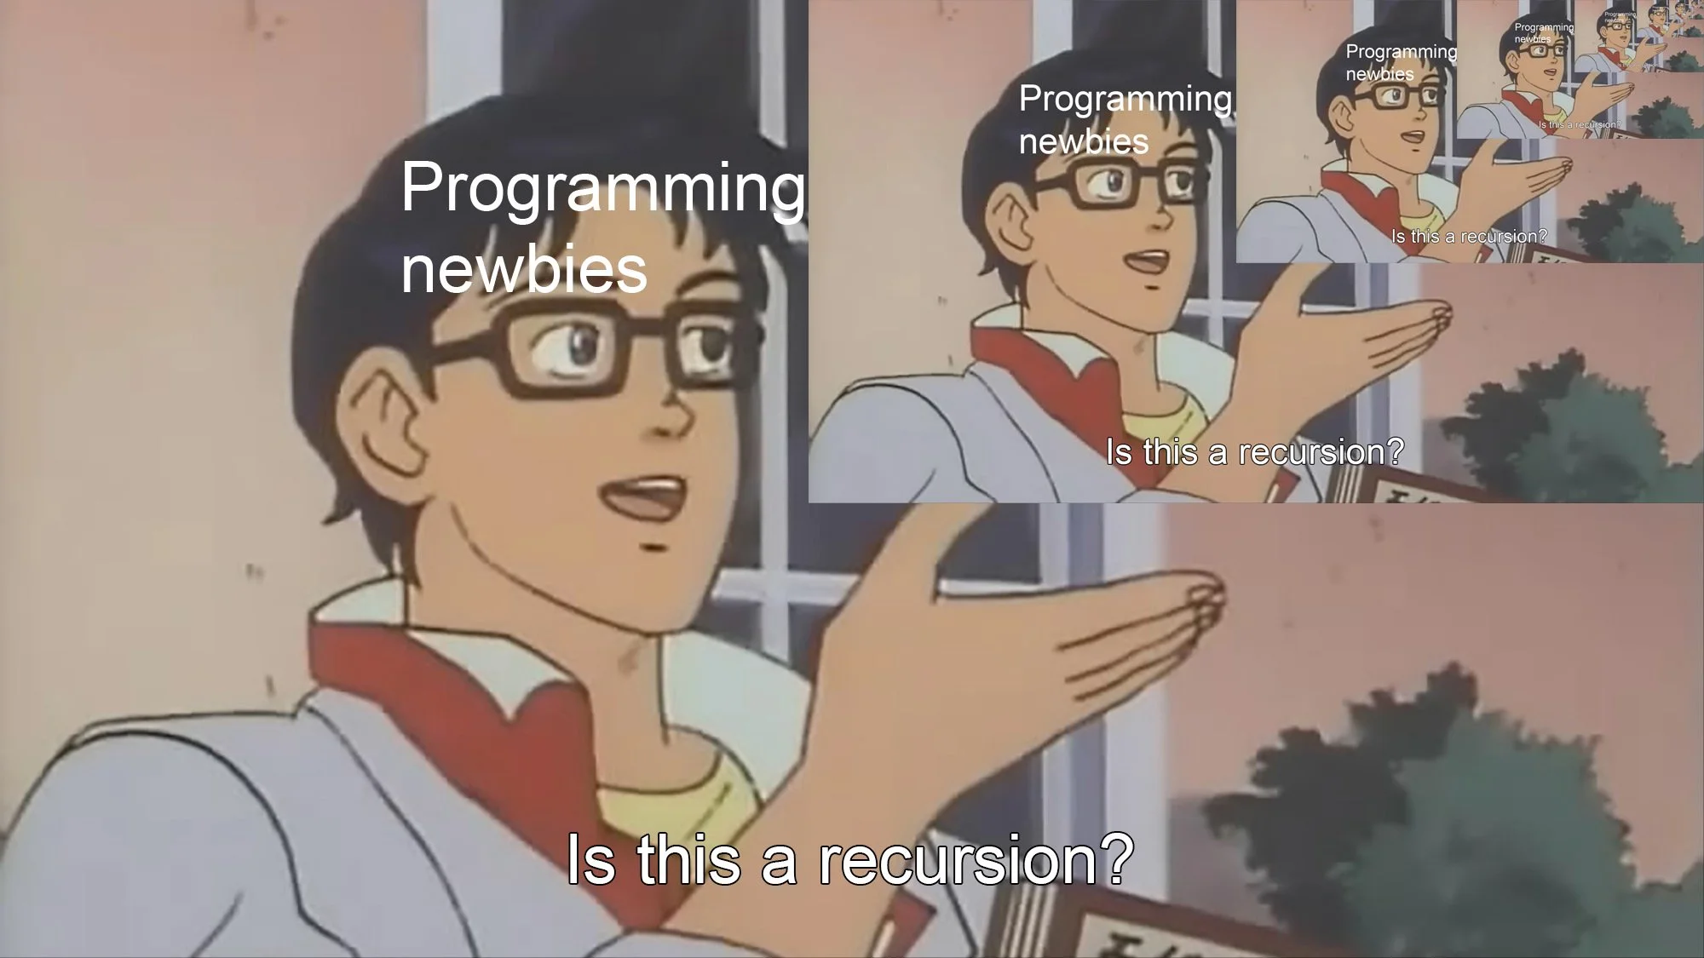
LOOPS
Loops are as their name saids are repeated iteration of certain commands(code). They are a very useful technique that a programmer can use.
However be careful to have an “exit”condition!
Without it you’ll end up in an infinite loop!

Slide 11
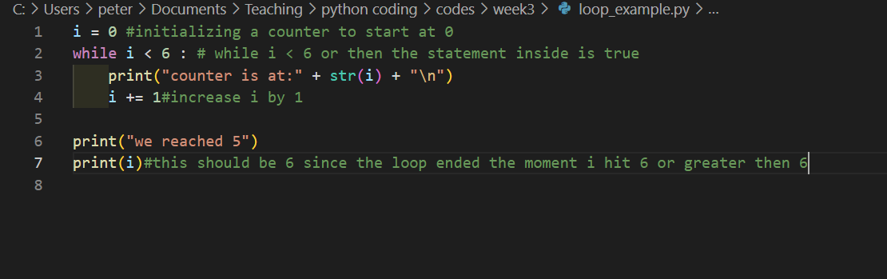
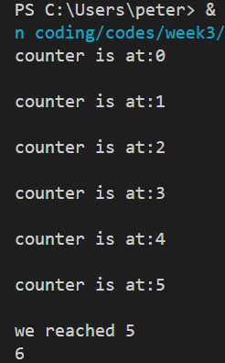
EXAMPLE

Slide 12
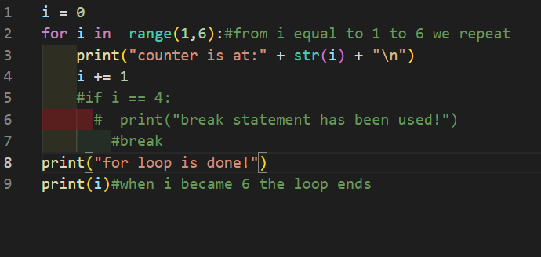
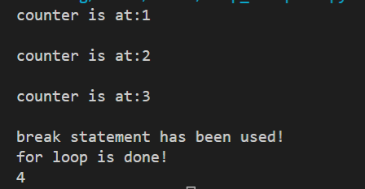
Different types of loop
What we have seen is a “while loop”
Other kind of loop we can use is “for loop”
For “item” in “iterator” (true)
Until we run out of items in iterations the loop will repeat.
You will notice that in comments,
There is an “if” statement if we remove “#” and add that code in the loop will break when the counter hits 4. This is using “break” statement. Literally to break out of the loop when the ‘exit’ condition has been met.

Slide 13
Assignment

Slide 14
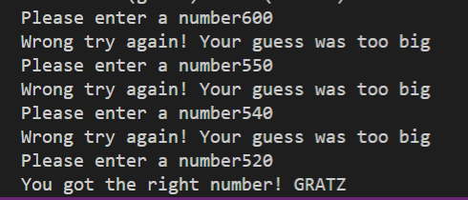
Pick a number between 1-1000
Then the user will input a number between 1 to 1000
The program then will either tell you if you are too low or too high
When the user guesses the correct number they win!

